Slide 1

Imperialism

Slide 2
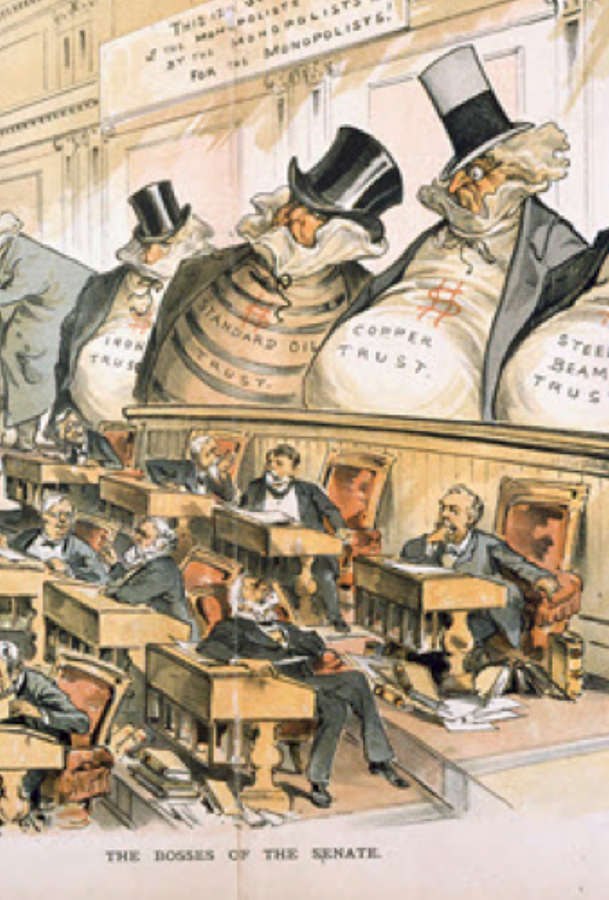
Capitalist Development
Cartelization- Examples include the “trusts” in the US, the German state-organized industries, and Japanese Zaibatsu. To compete with English dominance, needed bigness
Also needed protection, and every state that would be a major combatant in WWI put in place tariffs in the final years of the nineteenth century
All led to competition among capitalist states, played out as the struggle for breathing room

Slide 3
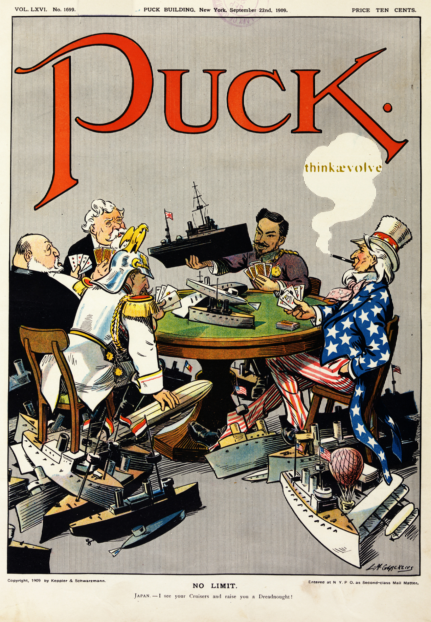
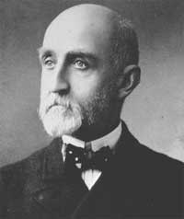
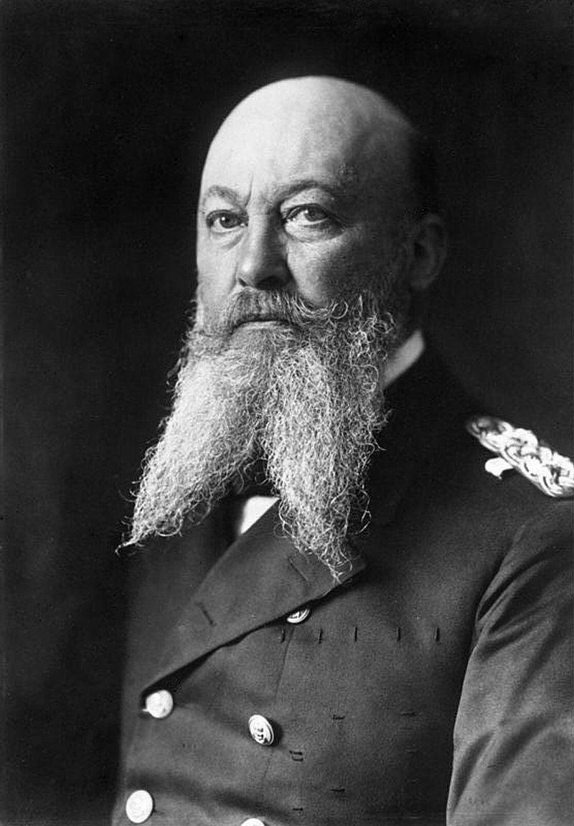
Industrialization and Naval Buildup
Pax Britannica (hundred years’ peace) rested on British naval supremacy
US and Germany pursued aggressive naval buildup in the 1890s and first decade of twentieth century
Requirements for Naval buildup: steel, iron, coal and later oil

Slide 4
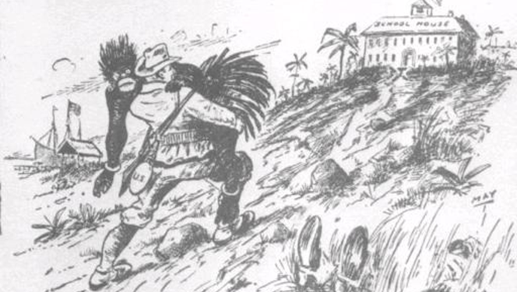
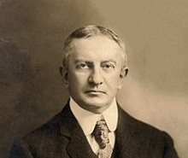
Theory of Imperialism
Entered the lexicon in the nineteenth century, in regular use by proponents and opponents by the 1870s
Pro-imperialist arguments:
(1) Civilized societies needed to spread their superior culture
(2) New developments in economic thought
(3) Gendered- urban societies were becoming effete
Critics pointed out hypocrisy of the first argument (see Mark Twain “To the Person Sitting in Darkness”)
Liberal economist JA Hobson advanced critique of imperialism based on economic argument
Marxists Rudolf Hilferding, Rosa Luxemburg, Lenin dug economic analysis of imperialism out of Marx’s Capital

Slide 5
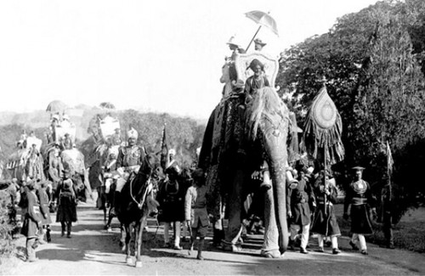
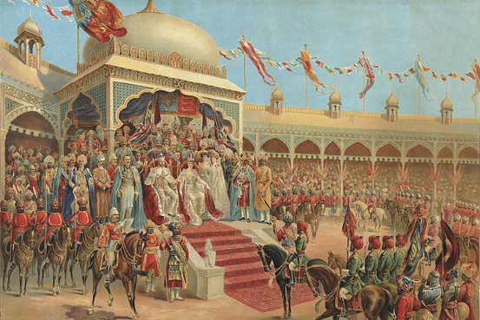
The Raj
India under the British Crown, 1858-1947
Modernized transportation and communication
Built consumers of British manufactures and suppliers of cotton, tea, and wheat
Unified the peninsula, and created the Indian identity, articulated often in opposition to colonial rule

Slide 6
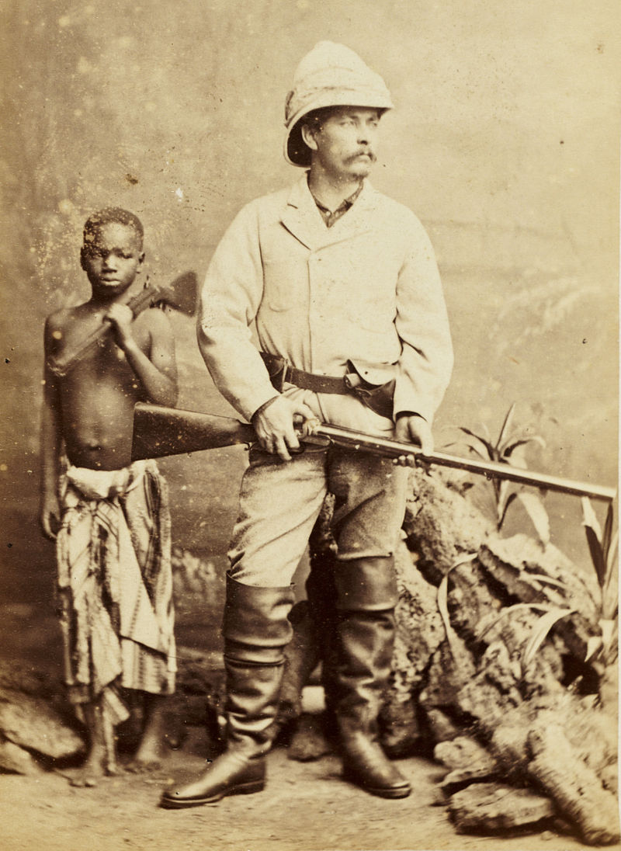
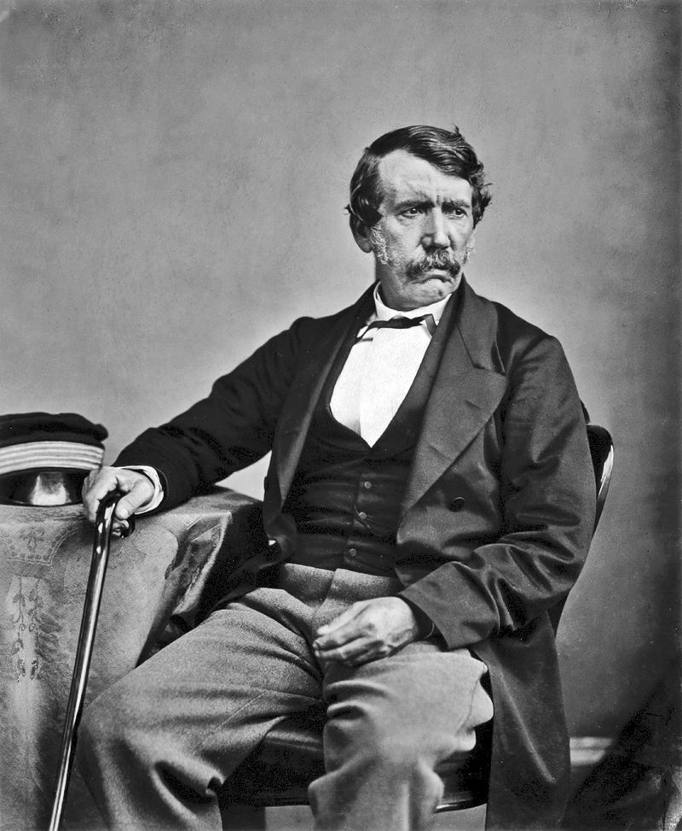
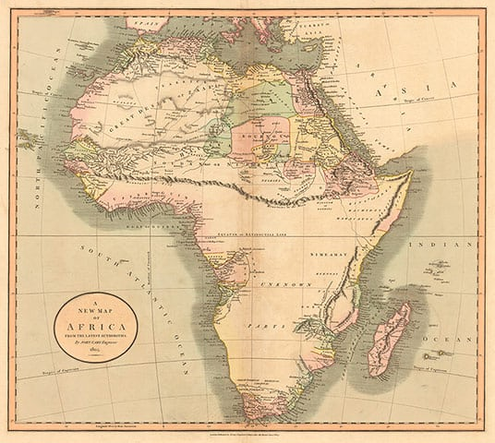
Explorers
Africa known as the “dark continent”
Ivory trade fueled deeper exploration
David Livingstone and Henry Morton Stanley gained celebrity for explorations

Slide 7
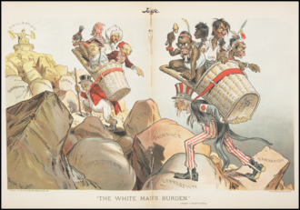
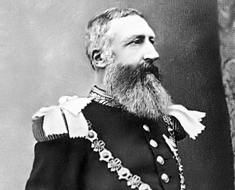
Colonialism and the White Man’s Burden
Rudyard Kipling published “White Man’s Burden” in 1899
Leopold began colonization of Congo under humanitarian banner
Pertained especially to Africa, but also US rationalization of imperialism in Latin America

Slide 8
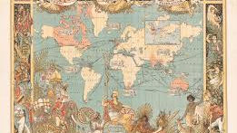
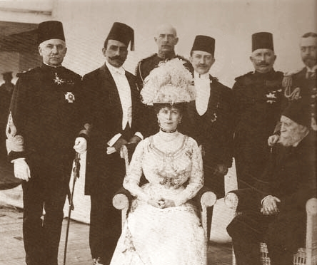
Britain Ramps Up
Protectionism of competitors began to hem in British export markets
Occupation of Egypt in 1882 precipitated scramble for Africa
Imperial Federation League (1884) proposed unifying all British colonies under a single federated administration

Slide 9
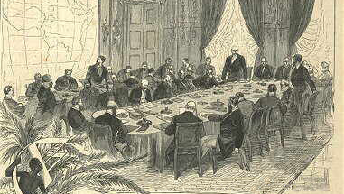
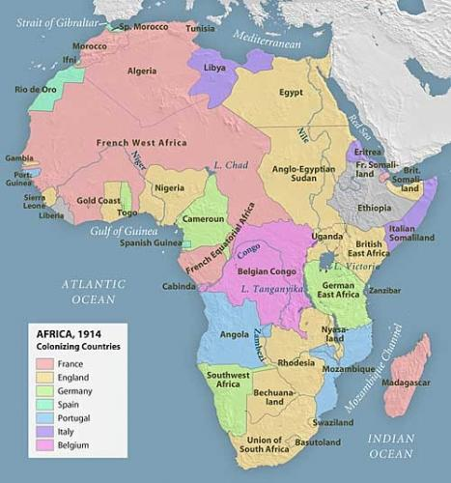
Berlin Conference
“Scramble for Africa” secured ivory, then rubber, then diamonds, eventually oil, coffee, tea

Slide 10
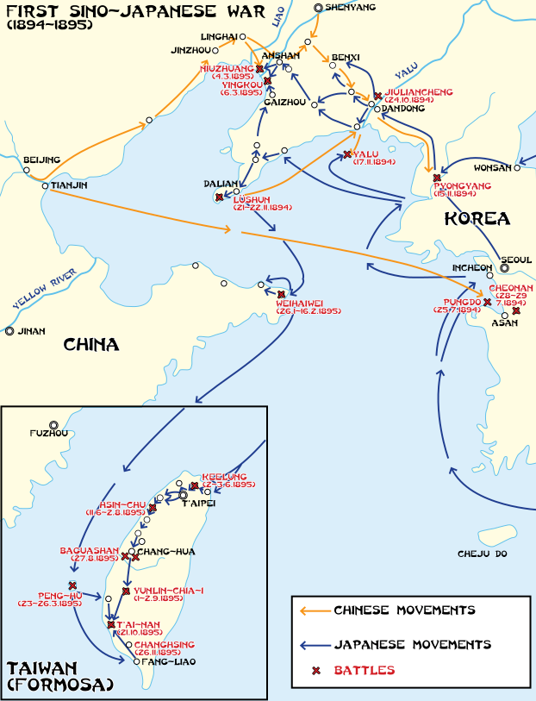
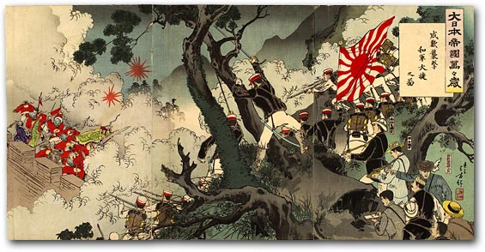
Sino-Japanese War
Rising Japan challenged declining China for control of Korea
Japanese victory indicated success of rapid industrialization following Meiji Restoration
Shifted East Asian BOP and announced Japan as an imperialist power

Slide 11
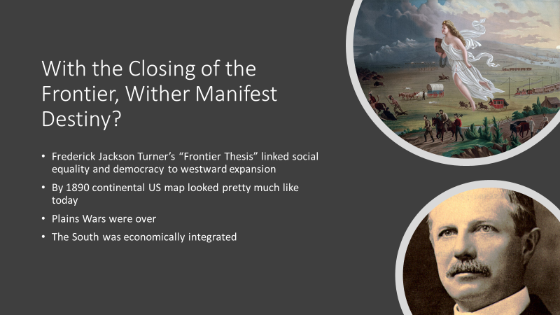

Slide 12
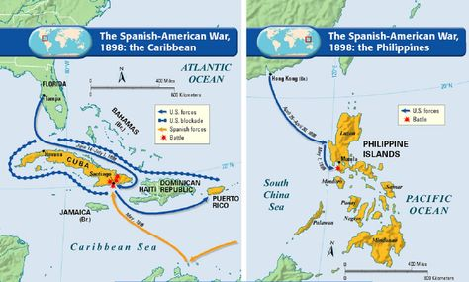
Spanish-American War

Slide 13
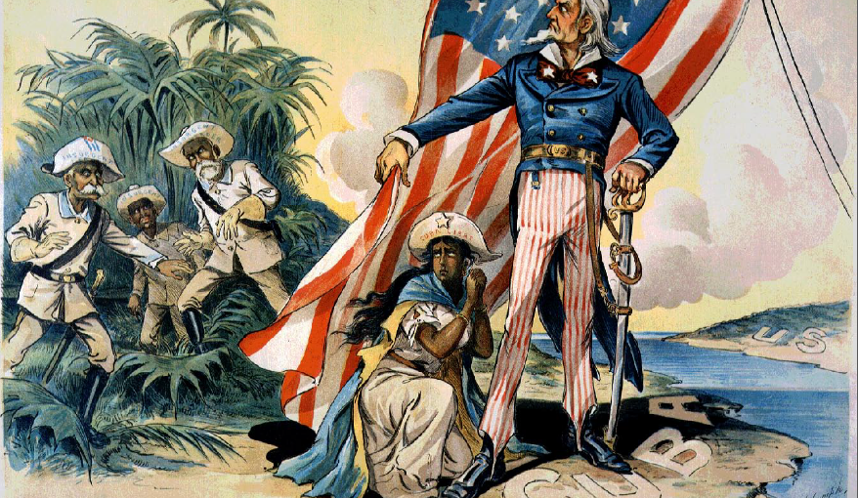
Cuba
Cuban independence movement picked up steam after 1895
US intervened as liberators against Spanish tyranny
Platt Amendment (1901) and Roosevelt Corollary (1904) turned Cuba into a virtual US colony
War helped make TR a household name

Slide 14
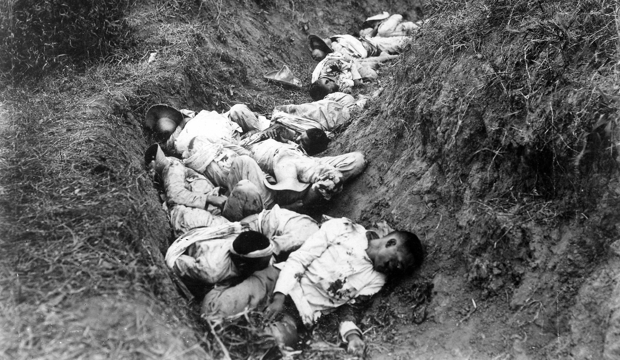
Philippine-American War
US Navy Admiral George Dewey easily defeated Spain in Battle of Manila Bay
US proceeded to annex Philippines
Pro-Spanish and Philippine Nationalist forces rejected US control
Estimated death tolls range from 300,000 to as much as 1 million

Slide 15
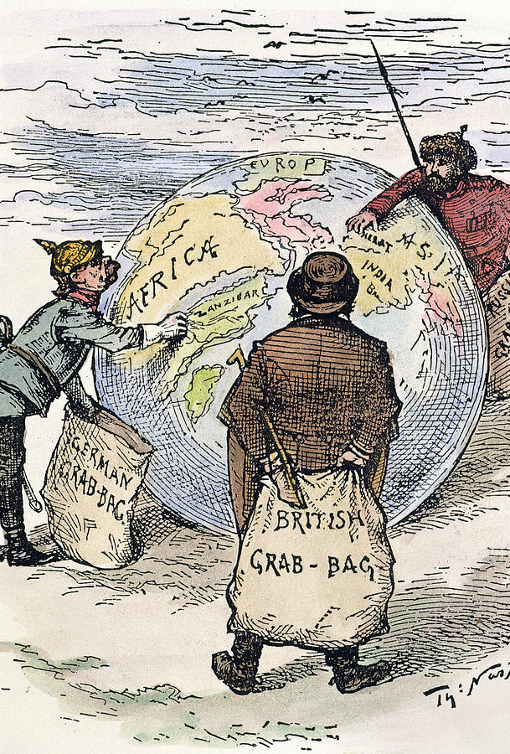
Consequences of Imperialism
Motivated by confluence of power and economic interdependence at the international level
Supply routes and spheres of influence became matters of state security
Creating modern nation-states where they didn’t exist in order to make the world amenable to capitalist investment, and capitalist social relations of production

